Slide 1

Text to Video Sahil Gupta 20 Swapnil karat 34 Sushant Yadav 71 Manisha Jaiswar 23
Jawahar Education Society’s
A.C Patil College of Engineering, Kharghar
Department of Artificial Intelligence & Data Science
Under the Guidance of
Name of Guide
Prof. S. A. Awate
Date:-

Slide 2
Introduction
Text-to-video generation is an innovative and emerging technology that bridges the gap between textual content and visual storytelling.
It empowers computers to transform written words into dynamic and engaging video content, opening up new horizons in content creation, communication, and entertainment.
This cutting-edge capability is driven by advancements in artificial intelligence and deep learning, enabling the automatic synthesis of video sequences that can bring narratives, ideas, and concepts to life.

Slide 3
Motivation
Enhanced Communication: Text-to-video generation can revolutionize the way we communicate. It allows us to convey complex ideas, emotions, and messages in a highly engaging and easily digestible format.
Content Creation Efficiency: For content creators, text-to-video generation can significantly speed up the video production process
Educational Advancements: For educators, this technology can transform the learning experience. It enables the creation of engaging educational content that can help students grasp complex subjects with greater ease, fostering a love for learning.

Slide 4
Literature review
Text-to-video synthesis approaches are categorized into autoregressive transformers that require extensive training on labeled video data and diffusion models (e.g., VideoDiffusion) trained end-to-end with large-scale supervision for generating high-quality videos.
A novel approach aims to enable text-to-video generation without external video training by making minimal modifications to pre-trained image models to induce temporal consistency, departing from the need for massive video supervision.

Slide 5
Analysis of Review
Early Foundations : The review appropriately begins with a discussion of the early foundations of text-to-video generation. By citing Sutskever et al. (2014) and Vinyals et al. (2015), it recognizes the pioneering work in neural networks and image-text alignment.
Video Synthesis and Alignment :The inclusion of Vondrick et al. (2016) and Xu et al. (2016) is crucial as it acknowledges the critical shift toward video synthesis using GANs and the creation of datasets for text-to-video alignment.

Slide 6
Objectives
To develop text to video generation system, that will generate videos when a text input is provided
High- quality videos with minimal generation time

Slide 7
Scope
The scope of a text-to-video generator is broad and it can be applied in various domains like-
Content creation
Educational materials
Real-Time Communication
Creative Art and Design

Slide 8
Problem Statement
Efficiency and Real-Time Generation: Text-to-video generation processes are often computationally intensive and time-consuming.
Personalization and Relevance: Many text-to-video systems lack the ability to personalize content based on individual preferences and user behavior.
Video Quality and Realism: The generated videos should meet high-quality standards, offering realism in visuals, audio, and overall coherence.
Scalability and Resource Efficiency: Many existing systems struggle to scale with increased demands, making them less suitable for large-scale applications.

Slide 9
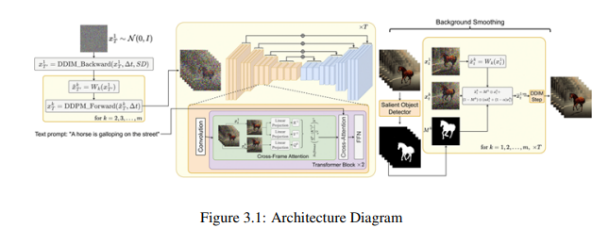
Proposed System
This project proposes a novel approach for text-to-video generation that can synthesize consistent video clips from only text prompts, without requiring any model training.
It builds on pre-trained text-to-image diffusion models like Stable Diffusion. The key idea is to modify such models to enforce temporal consistency across generated frames.

Slide 10
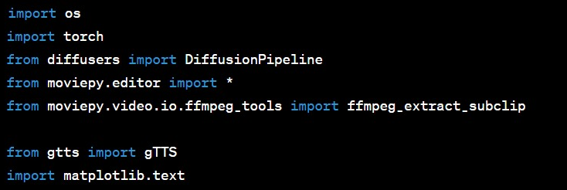
Proposed System
The core of the architecture is a pre-trained text-to-image diffusion model like Stable Diffusion (SD).
SD contains an encoder-decoder model and a diffusion process trained to generate the original image from the noisy training data using text prompts.
Step 1 : Importing all the dependencies.

Slide 11
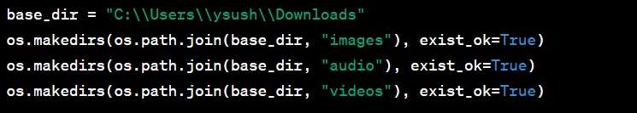
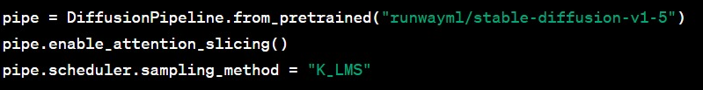
Proposed System
Step 2 : Setting up the directory structure for storing images, audio, and videos.
Step 3 : Initialization of pre-trained Diffusion model is done using the "runwayml/stable-diffusion-v1-5" configuration.

Slide 12


Proposed System
Step 4 : Reads text data from a file, then splits the text into paragraphs.
Step 5 : Two variables are initialized: clips to store video clips and cumulative duration to keep track of the duration of the video clips.

Slide 13
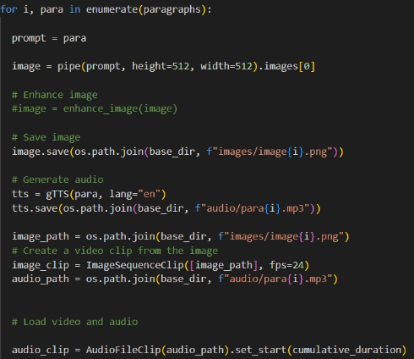
Proposed System
Step 6 :Iterating through a list of paragraphs and creating video clips for each paragraph.

Slide 14
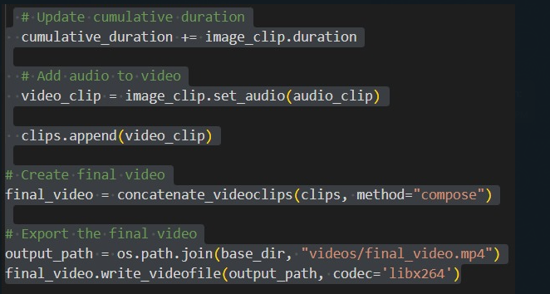
Proposed System
Step 7: In this part, we are assembling the individual video clips for each paragraph into a final video

Slide 15
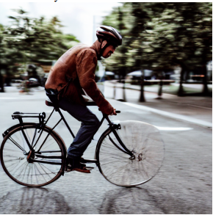
Observations
Input : ‘Man riding a bike’
Output:

Slide 16
Conclusion
This project is for text-to-video generation without requiring any training or tuning of models.
It proposed a lightweight yet effective approach to adapt pre-trained text-to-image diffusion models like Stable Diffusion for temporally consistent video synthesis using just text prompts.
The core technical innovations include encoding motion dynamics in latent codes to induce global background consistency and using cross-frame attention to preserve local object identities and appearances throughout the generated video.

